Slide 1
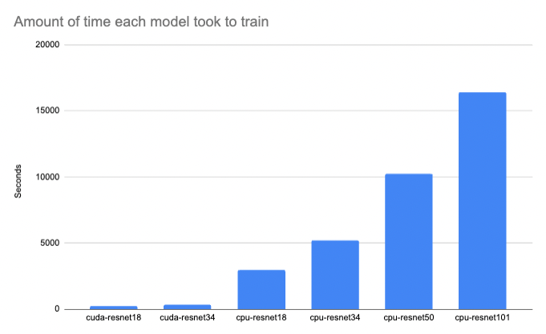
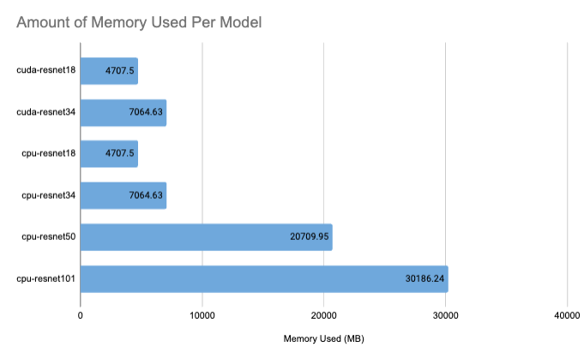
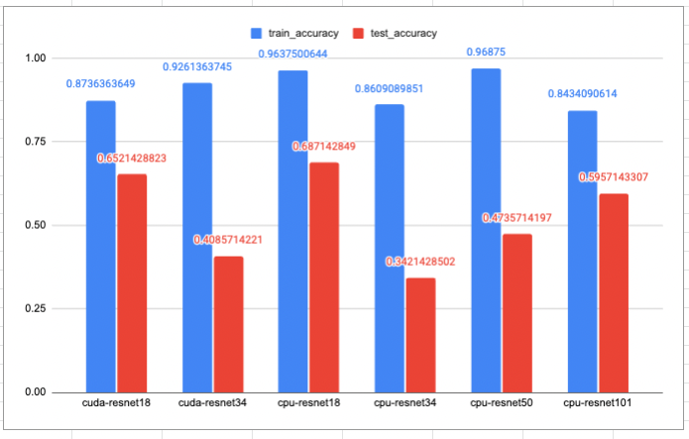




Computer Vision does not have to rely on the biggest and most expensive models to produce viable results.
Access to vision systems, especially for AI on the Edge is not always costly to get good results
Jason Chalom (711985)¹
Supervisor: Dr Richard Klein¹
¹University of the Witwatersrand, South Africa
Jason Chalom¹
Supervisor: Dr Richard Klein¹
¹University of the Witwatersrand, South Africa
RAIL Lab

